Slide 1



Contributing to a sustainable future
Section 2.2: Addressing the challenges of sustainable development

Slide 2

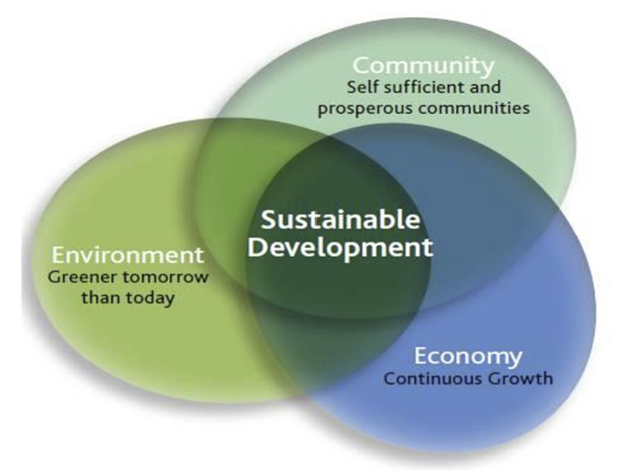
What is sustainable development?
Sustainable development is a general concept about the need to strike a balance between meeting the current needs of humanity and protecting the interests of future generations, including their need for a safe and healthy environment.
It is "development that meets the needs of the present generation without compromising the ability of future generations to meet their own needs."¹
¹ Butlin, John (April 1, 1989). Our common future. By World commission on environment and development. (London, Oxford University Press, 1987, pp.383 £5.95.). Journal of International Development. Vol. 1, No. 2. pp. 284-287. doi:10.1002/jid.3380010208. ISSN 1099-1328

Slide 3
History and evolution of the concept of sustainable development
Early beginnings (before the XX century): Awareness of limited natural resources, first attempts at rational forest management and nature conservation, ideas of social justice and welfare.
The early 20th century - 1960s: the growth of environmental problems as a result of industrialization; the emergence of the first environmental movements and organizations; the publication of Rachel Carson's Silent Spring (1962), which drew attention to the effects of pesticides.
1970s: first international conferences and reports: the Club of Rome's report "Limits to Growth" (1972) - a warning about the consequences of unlimited growth; the first UN Environment Conference in Stockholm (1972) - the beginning of international environmental policy; the emergence of the term "ecodevelopment" - an emphasis on the integration of environmental and socio-economic aspects.
1980s: Conceptualization of sustainable development: Brundtland Commission report "Our Common Future" (1987) - definition of sustainable development as "development that meets the needs of the present without compromising the ability of future generations to meet their own needs"; emphasis on three components of sustainable development: economic, social and environmental.
1990s: Rio Conference and Agenda 21: UN Conference on Environment and Development (Earth Summit) in Rio de Janeiro (1992) - adoption of Agenda 21 as a global action plan; adoption of the UN Framework Convention on Climate Change and the Convention on Biological Diversity.
2000s: The Millennium Development Goals (MDGs) and the Johannesburg Summit: adoption of the Millennium Development Goals (2000) - focus on poverty, hunger, disease and environmental sustainability; World Summit on Sustainable Development in Johannesburg (2002) - reaffirmation of the principles of sustainable development and emphasis on its practical implementation.
2020s - present: emphasis on integrating the SDGs into national policies and business strategies; growing awareness of the interconnectedness between environmental, social and economic issues; search for innovative solutions and technologies to achieve sustainable development; strengthening the role of civil society and youth in promoting sustainable development.

Slide 4
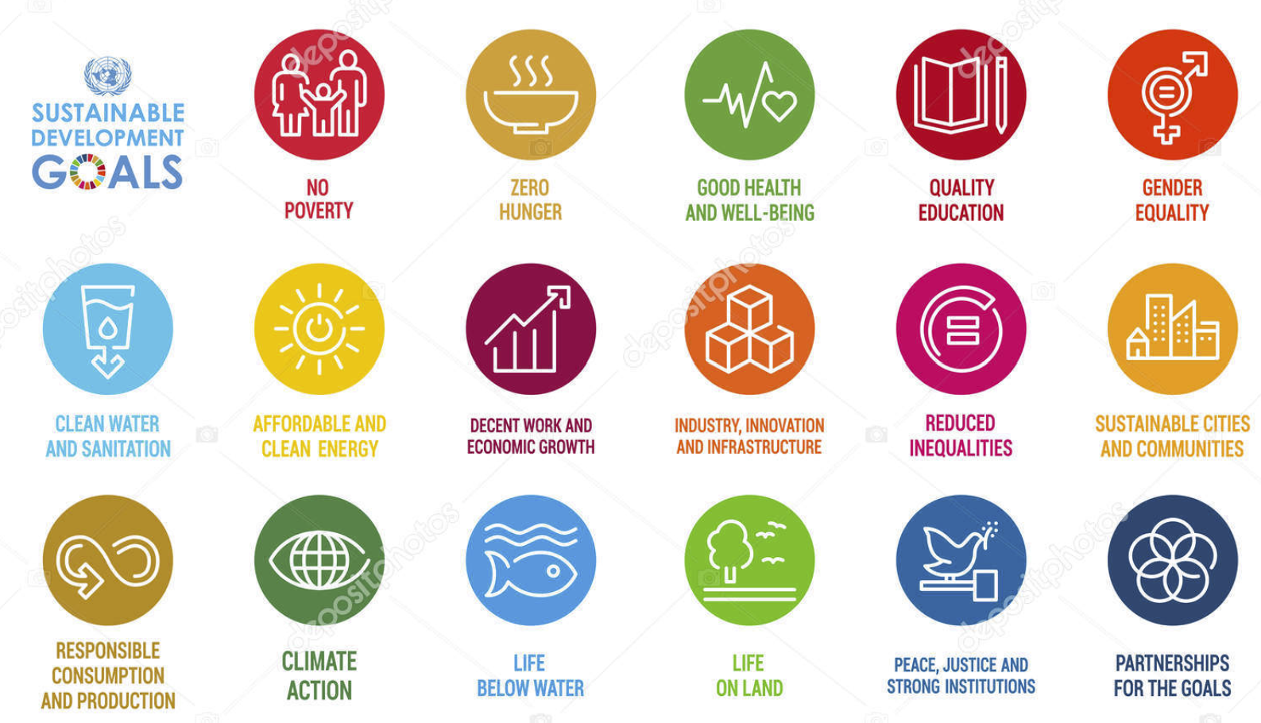
Sustainable Development Goals by 2030

Slide 5



Global challenges of today
- Climate change:
Causes and consequences (global warming, extreme weather events, sea level rise).
Connections with various industries (energy, agriculture, construction, transportation).
- Loss of biodiversity:
Causes (habitat destruction, pollution, overexploitation of resources).
The importance of biodiversity for ecosystems and humanity.
Impact on various sectors (agriculture, pharmaceuticals, tourism).
- Environmental pollution:
Types of pollution (air, water, soil, waste).
Sources and consequences for human health and ecosystems.
Relevance to engineering, chemistry, and healthcare.

Slide 6


Global challenges of today
- Inequality and social injustice:
Different forms of inequality (economic, gender, social, racial).
Impact on the stability of society and economic development.
Connections with sociology, political science, economics, and law.
- Depletion of natural resources:
Limited non-renewable resources (fossil fuels, minerals).
Implications for industry and future generations.
Importance for geology, mining, and energy.

Slide 7

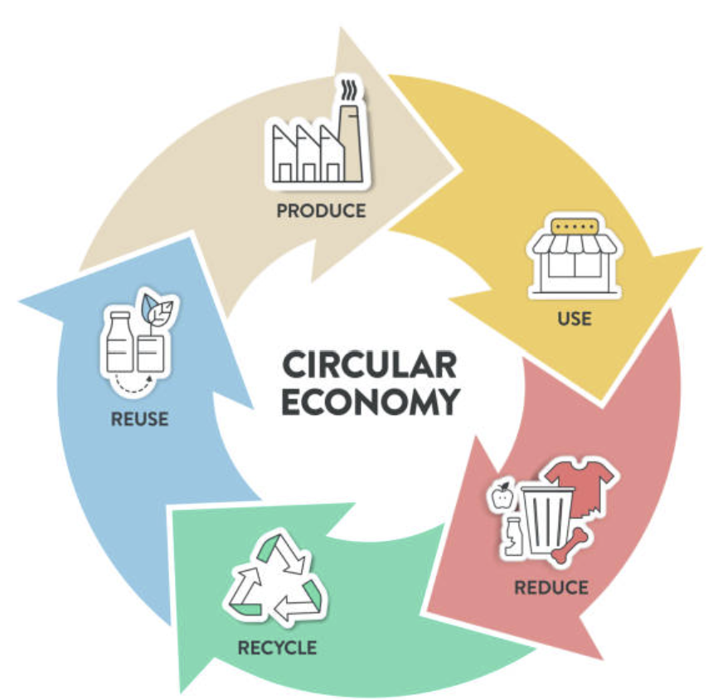
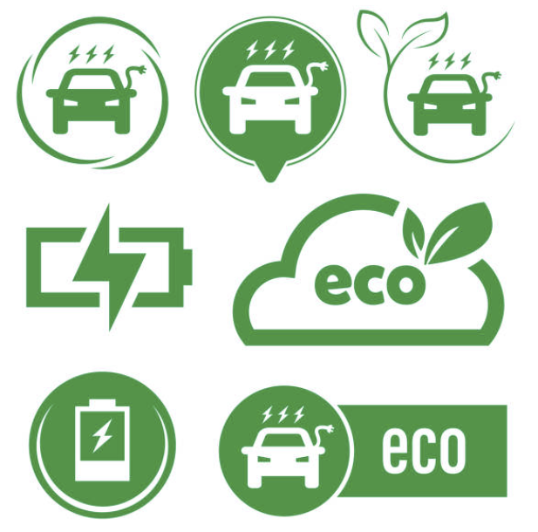
Approaches to solving sustainable development problems
Innovations and technologies:
The role of green technologies (renewable energy (solar, wind, hydropower), energy efficiency in construction, transportation, and industry).
Circular economy and sustainable production (transition from a linear "produce-use-discard" model to a cyclical model where resources are reused and used efficiently. Sustainable production methods with reduced environmental impact).
Examples of technological solutions in various industries (e.g., in the agricultural sector: precision agriculture; in transportation: electric vehicles; in IT: smart cities, etc.)

Slide 8


Approaches to solving sustainable development problems
Policy and regulation:
International agreements and national legislation (Paris Agreement, UN SDGs, national sustainable development strategies, environmental norms and standards).
Economic instruments (carbon taxes, subsidies for green technologies, pollution fees, green bonds).
The role of the government and international organizations (development and implementation of policies, monitoring their implementation, international cooperation, provision of financial and technical assistance).

Slide 9

Approaches to solving sustainable development problems
Education and awareness (formation of a responsible society):
The importance of forming sustainable thinking from an early age (inclusion of sustainable development issues in the curricula of schools and kindergartens.
The role of universities in training specialists in sustainable development (specialized courses and programs, research).
Information campaigns and public involvement (social advertising, public lectures, volunteer initiatives, environmental campaigns).

Slide 10

Approaches to solving sustainable development problems
Cooperation and partnership:
The importance of forming a sustainable mindset from an early age (inclusion of sustainable development issues in the curricula of schools and kindergartens.
The role of universities in training specialists in sustainable development (specialized courses and programs, research).
Information campaigns and public involvement (social advertising, public lectures, volunteer initiatives, environmental campaigns).

Slide 11

Approaches to solving sustainable development problems
Ethical and philosophical aspects:
Principles of responsibility and justice for future generations (awareness of the duty to preserve the planet for posterity).
Rethinking values and consumer patterns (rejection of excessive consumption, focus on quality and durability, and conscious choice).
Discussions about the limits of growth and quality of life (finding a balance between economic development and environmental protection, prioritizing quality of life over quantity of consumption).

Slide 12
Questions for discussion
Is the awareness of the urgency of sustainable development issues sufficient to stimulate real action at the global and local levels?
What are the most effective ways to integrate different approaches (innovation, policy, education, cooperation, ethics) to achieve sustainable development?
How can technological innovations and circular economy principles be maximized to accelerate the transition to a sustainable future?
How can educational systems and information campaigns be transformed to create a deeper understanding and active support for sustainable development in society?
What specific actions can each person, regardless of their profession or social status, take to make a meaningful contribution to sustainable development?
How can we convince governments, businesses, and society that investing in sustainable development is not a burden, but a profitable strategy to ensure future prosperity?

